Slide 1
Carrier Sense Multiple Access with Collision Avoidance
Name – Arindam Roy Stream – CSE Year – 3rd Semester – 6th
Roll No. – 16800117057 Subject – Computer Network Assignment

Slide 2
Carrier Sense Multiple Access with Collision Avoidance
Carrier Sense Multiple Access with Collision Avoidance (CSMA/CA) is a network protocol for carrier transmission that operates in the Medium Access Control (MAC) layer. In contrast to CSMA/CD (Carrier Sense Multiple Access/Collision Detection) that deals with collisions after their occurrence, CSMA/CA prevents collisions prior to their occurrence.
CSMA/CA is used in wireless network. In wireless network most of the energy is lost due to transmission. So collision can add 5% - 10% additional energy which can’t be well detected.

Slide 3
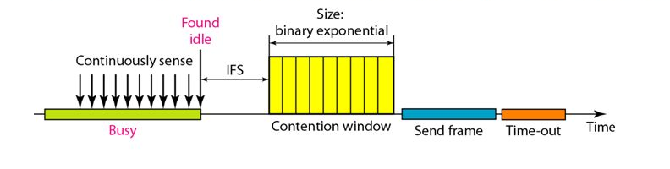
Collisions are avoided using three CSMA/CA strategies:
Inter-Frame Space or IFS
Contention Window
Acknowledgements
In this diagram at first the media will be checked continuously. And if the media is not idle then obviously there will be no question of transmission of data. But when the media will be checked that it is found idle then it will wait for Inter Frame Space or IFS. Then after waiting for IFS there is a binary exponential i.e., Contention Window, which means there will be number of slots are present. After that it will send a frame and then it will timeout and the X – axis we have brought at that time so this is the respective logic or sequence in which the CSMA/CA works.

Slide 4
Algorithm
The algorithm of CSMA/CA is:
When a frame is ready, the transmitting station checks whether the channel is idle or busy.
If the channel is busy, the station waits until the channel becomes idle.
If the channel is idle, the station waits for an Inter-frame gap (IFG) amount of time and then sends the frame.
After sending the frame, it sets a timer.
The station then waits for acknowledgement from the receiver. If it receives the acknowledgement before expiry of timer, it marks a successful transmission.
Otherwise, it waits for a back-off time period and restarts the algorithm.

Slide 5
Flow Chart
START
N = 0
Idle Channel
NO
YES
Wait IFS time
Still Idle ?
NO
YES
Contention Window Of Size 2^{n} -1
Choose a random number R between 0 and 2^{n} -1
Wait R slots
Send Frame
NO
NO
Ack. Received?
n> 15
n = n+1
Wait time-out
YES
YES
Abort
Success

Slide 6
Flow Chart Explanation
First we are starting with the START command.
And then the value of N = 0.
Then we are channel is idle or not. Then it will go on continuously checking. Now if the channel is idle it wait for the IFS time. Then it will check if its still idle or not. If its not idle then again it will go for continuous checking and if still idle it will go to the contention window of size 2^{n} -1. Then it will wait for R slots. And after that it will send frames and timeout will be there after that.
Then it will again check for acknowledgement. If the acknowledgement is received then the process is successful . If the acknowledgement is not received then the value of n will increase by 1 and when the value of n is greater than 15 then the process will abort or go for continuous checking again.

Slide 7
Advantages And Disadvantages Of CSMA/CA
Advantages
CMSA/CA prevents collision.
Due to acknowledgements, data is not lost unnecessarily.
It avoids wasteful transmission.
It is very much suited for wireless transmissions.
Disadvantages
The algorithm calls for long waiting times.
It has high power consumption..

Slide 8
Thank You
Name – Arindam Roy Stream – CSE Year – 3rd Semester – 6th
Roll No. – 16800117057 Subject – Computer Network Assignment

